Slide 1
MIS Paper Revision Plan

Slide 2
Outline
Summary of paper idea (page 1~5)
Review panel’s major concern (page 6~7)
SE’s suggestion
Our plan

Slide 3
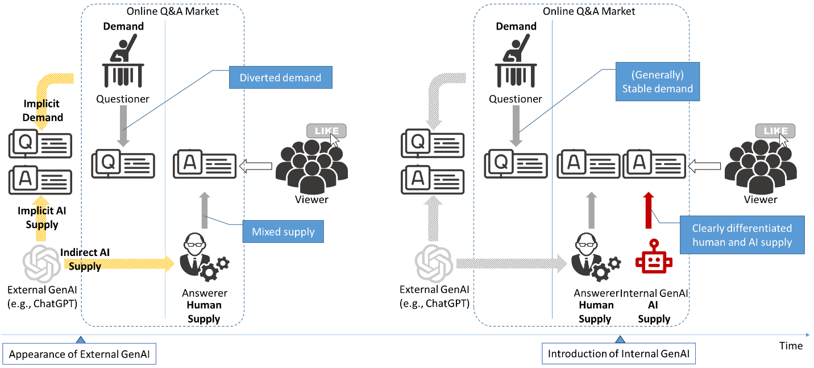
Background
Research Question: ????????????????????????????

Slide 4
Original Framing (not drawn in the paper)
Quality Degradation
Viewer Recognition
Attention Diversion
(-)
Elevated Expectations
Has AI Answer
Source Effect
(-)
Answer Participation
Content Effect
Position Effect

Slide 5
Reviewer’s concerns
Does not have theretical XXXXXXX

Slide 6
SE’s suggection
Xxxx
Xxxx
Xxxxxx : Our pick √

Slide 7
Revise of the Focuse of the Paper
Quality Degradation
Viewer Recognition
Attention Diversion
Reason: Less thretical value
Xxxx
xxx
(-)
Elevated Expectations
Has AI Answer
Source Effect
(-)
Answer Participation
Content Effect
Reason: Difficult to identify,
Questioned by reviewers
Position Effect

Slide 8
New Framework
In last version
New
Answer Participation
Has AI Answer
Answer Quality
Previous Source Effect
AI Answer Length
AI Answer Quality
Questioned by reviewer
Fast Processing
Slow Processing
Previous Content Effect

Slide 9
AI’s Two Roles in Competition with Human
Answer Participation
Has AI Answer
Answer Quality
Humans view AI as a weaker competitor
AI Answer Length
AI Answer Quality
Fast Processing
Slow Processing
AI content generate concrete competition

Slide 10
Two Different Content Signals for Two Decisions
Answers make two decisions
1) whether to participate
2) how to contribute
Participation is a fast decision which relies on fast signals, such as length
Contribution is a slow decision which relies on slow signals, such as quality
Answer Participation
Has AI Answer
Answer Quality
AI Answer Length
AI Answer Quality
Fast Processing
Slow Processing
Dual Processing

Slide 11
Hypotheses
Core Logic:
Humans view AI as a weaker competitor (without seeing content),
yet AI content triggers strong competitive dynamics that deter human contributions and elevate human answer quality.
DV: | Contribution (Fast) | Answer Quality (Slow)
AI Presence (as a weaker competitor) | H1: ↑ (easy win → motivates entry) | H3: ↓ (weak rival → complacency)
Moderated by Length | H2: attenuates H1 (occupied space → deters entry) | —
Moderated by Quality | — | H4: reverses H3 (credible rival → raises the bar)
Detailed theoretical development, see next slide

Slide 12
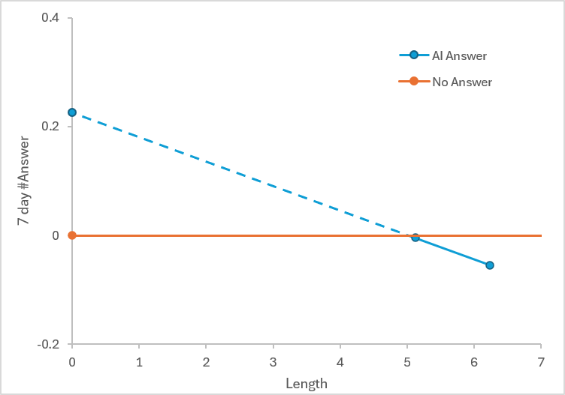
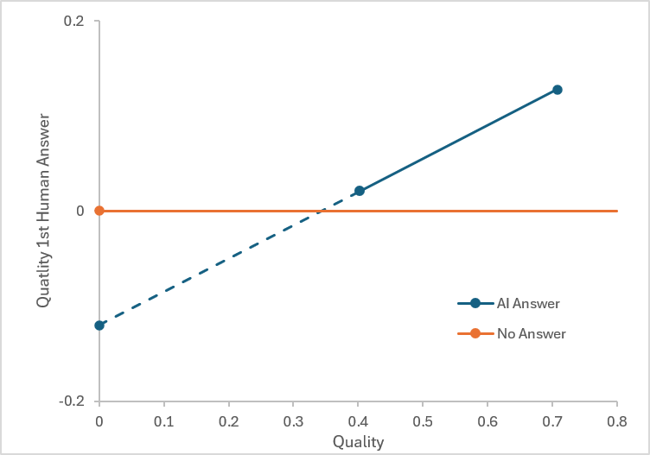
Preliminary Finding
 | (1) | (2) | (3) | (4)
DV: | number of human answers within 7 days |  | first human answer quality
AI_{i} | -0.046 *** | 0.226 ** | 0.000 | -0.120 .
 | (0.011) | (0.085) | (0.007) | (0.067)
AI_{i} * AILength_{i} |  | -0.045 ** |  | -0.013
 |  | (0.014) |  | (0.011)
AI_{i} * AISimWithLLM_{i} |  | -0.038 |  | 0.350 ***
 |  | (0.051) |  | (0.034)
question controls | √ | √ | √ | √
questioner controls | √ | √ | √ | √
question timing FE | √ | √ | √ | √
N | 3,613 | 3,603 | 2,685 | 2,685

Slide 13
Inclusion of Prior Findings (Su et al)
Su et al. 2023
AI encourage contribution
Our finding in las round
AI deter contribution
True reason:
Content deter contribution; Label encourage contribution

Slide 14
Competition Effect on Contribution (Fast Processing — Length as Signal)
Has AI Answer
Answer Participation
AI Answer Length
Fast Processing
H1: AI presence increases human contribution.
Humans perceive AI as a “weak” competitor (because of competitive arousal – experts believe SegementFault is their expert-specific area)
Regardless of AI answer length or quality, the competitive trigger stimulates a baseline impulse to respond.
H2: The competitive crowding-out is stronger when the AI answer is longer.
Length is a fast-processed heuristic for how “comprehensive" the competitive space is.
A longer AI answer signals a more formidable competitive barrier → the "easy win" perception erodes → the baseline positive contribution effect is attenuated or reversed.

Slide 15
Competition Effect on Answer Quality (Slow Processing — Quality as Benchmark)
Has AI Answer
Answer Quality
AI Answer Quality
Slow Processing
H3: AI presence decreases human answer quality.
Facing a perceived weaker competitor, humans become complacent → reduced effort investment → "I don't need to try hard to beat this" → lower quality.
Regardless of AI answer length or quality, the baseline competitive posture toward a "weak" rival lowers the quality bar humans set for themselves.
H4: The negative quality effect reverses when AI answer quality is high.
High AI quality can only be assessed through slow, deliberate processing → once recognized, it shatters the "weak competitor" assumption.
A high-quality AI answer serves as a visible benchmark to surpass → triggers genuine competitive effort → humans invest more to demonstrate superiority → quality rises.
"The AI is actually good — I must prove I'm better."

